Slide 1
Bubble Sheet Scanner
DIP mini-project by
2017BTECS00005
2017BTECS00018
2017BTECS00050

Slide 2
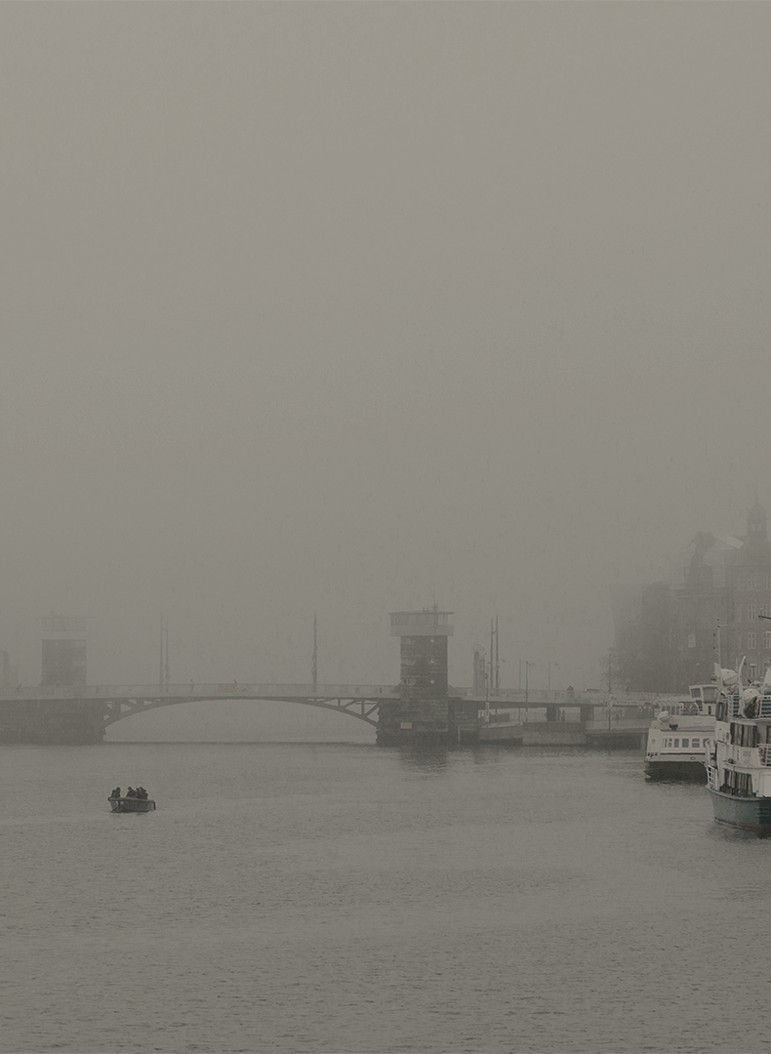
THE PROBLEM
Generally, it takes a lot of time to check exam paper manually and result might be incorrect due to human error. So, we need an application that can do this task with 100% accuracy.

Slide 3
METHODOLOGY
01
02
Apply Gaussian Blur and detect edges in image using Canny edge detection algorithm
Extract the top-down, birds-eye-view of image
03
04
Extract the set of bubbles and determine marked one
Calculate the result with the help of correct answer key

Slide 4



MAJOR REQUIREMENTS
Python
OpenCV
Numpy

Slide 5
STEPS TO BUILD
Detect the exam sheet in an image
Extract set of bubbles from perspective transformed exam
Sort bubbles into rows
Determine the marked answer for each row
Lookup the correct answer in our answer key
Repeat for all questions in the exam

Slide 6
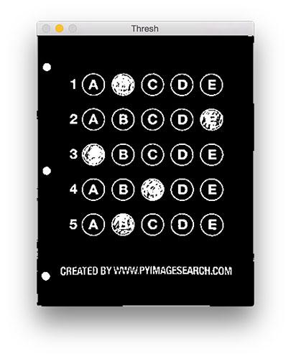
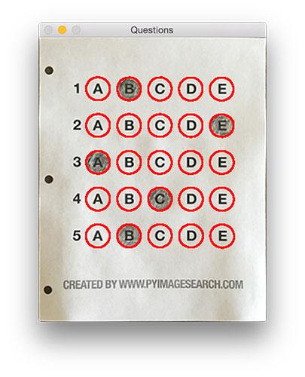
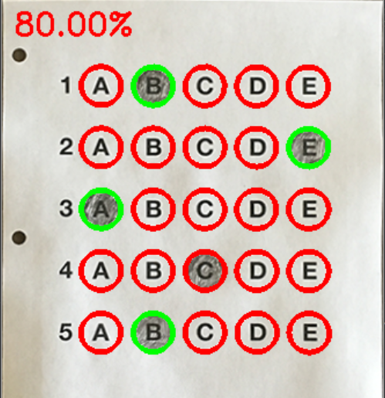
Observations

Slide 7
REFERENCES
Optical mark recognition
OpenCV
Medium.com

Slide 8
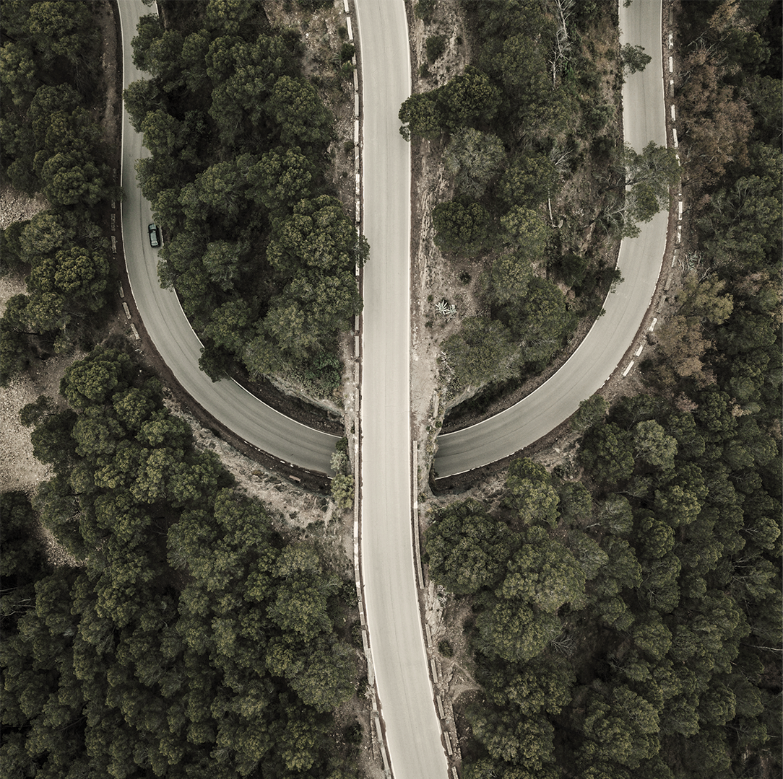
THANK YOU!

